Slide 1

IMACS: A Framework for Performance Evaluation of Image Approximation in a Closed-loop System
Sajid Mohamed, Sayandip De, Konstantinos Bimpisidis, Vishak Nathan, Dip Goswami, Henk Corporaal, Twan Basten
Eindhoven University of Technology, The Netherlands

Slide 2
What is “approximate computing”?
Particular Technology Node

Slide 3
What is “approximate computing”?
Particular Technology Node

Slide 4
What is “approximate computing”?
Particular Technology Node

Slide 5
What is “approximate computing”?
Particular Technology Node

Slide 6
What is “approximate computing”?
Particular Technology Node

Slide 7
What is “approximate computing”?
Particular Technology Node
Application Dependant

Slide 8
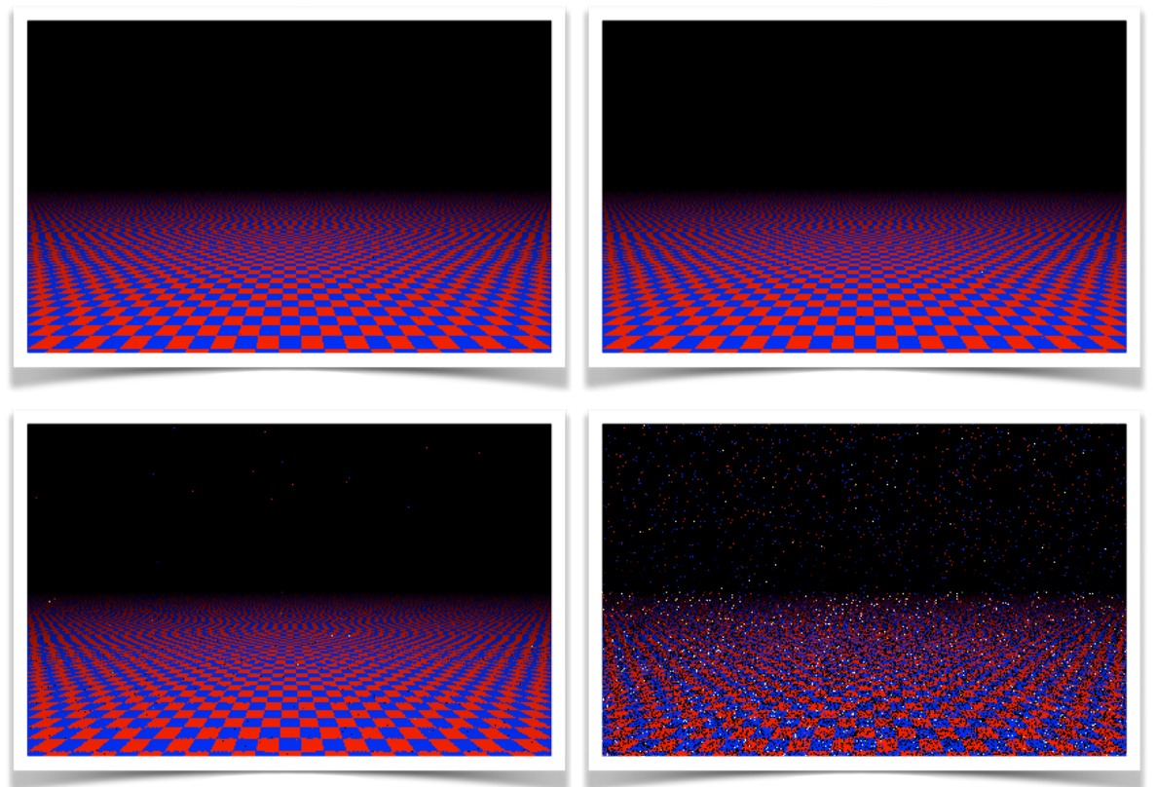
What is “approximate computing”?
Particular Technology Node
Application Dependant
[Image Source: http://arch2neu.saclay.inria.fr/NIAC/luis_ceze.pdf]

Slide 9
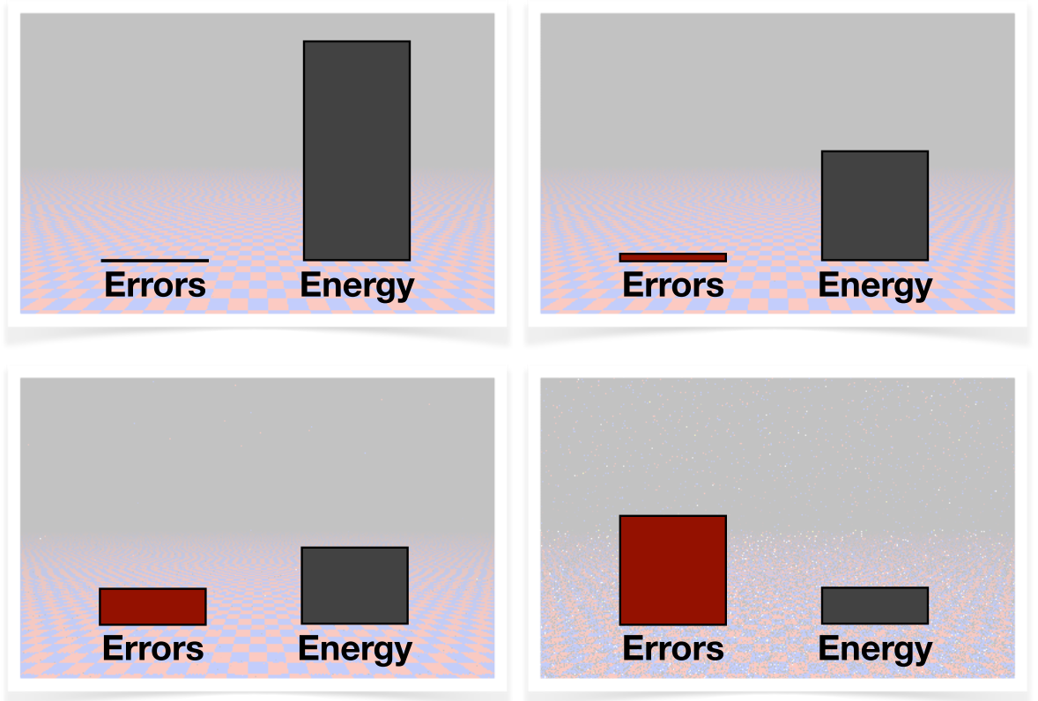
What is “approximate computing”?
Particular Technology Node
Application Dependant
[Image Source: http://arch2neu.saclay.inria.fr/NIAC/luis_ceze.pdf]

Slide 10
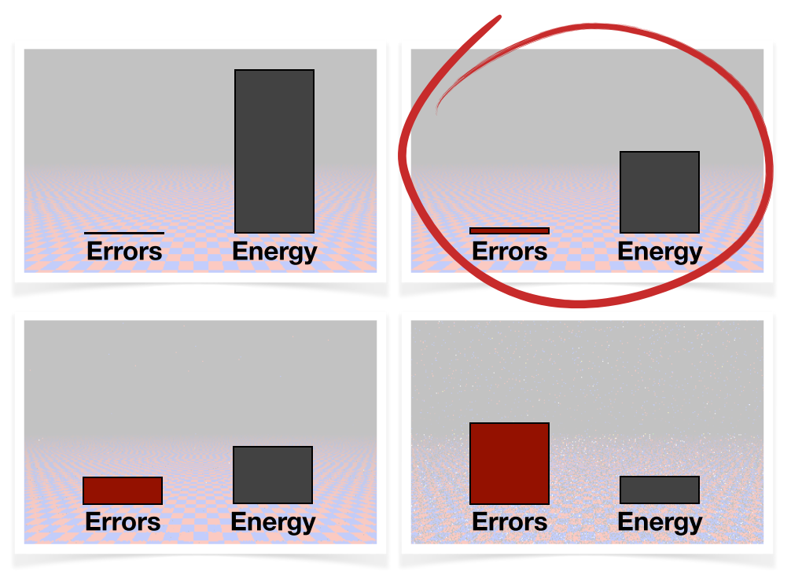
What is “approximate computing”?
Particular Technology Node
Application Dependant
[Image Source: http://arch2neu.saclay.inria.fr/NIAC/luis_ceze.pdf]

Slide 11
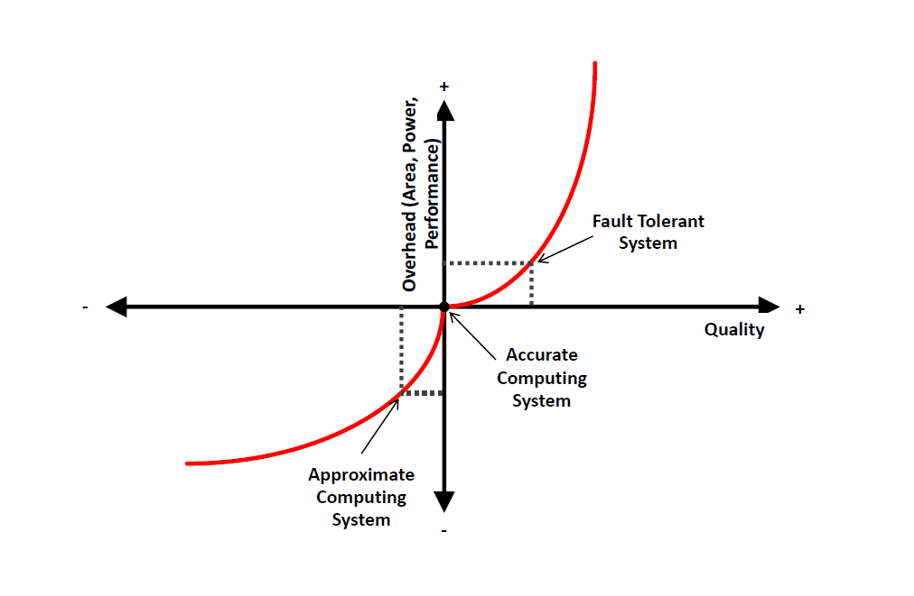
Opposite View to Traditional Computing
[Source: A Comprehensive Analysis of Approximate Computing Techniques: From Component- to Application-Level [DATE 2019]

Slide 12
Approximations across the system stack
Algorithms
Imprecise Hardware
Precision Scaling
Voltage Over-Scaling
Logic
Approximation
Neural Acceleration
Loop Perforation
Precision Scaling
SW
Approximation
Voltage Scaling in SRAMs
Refresh Rate Modulation in DRAMs
Data
Approximation

Slide 13


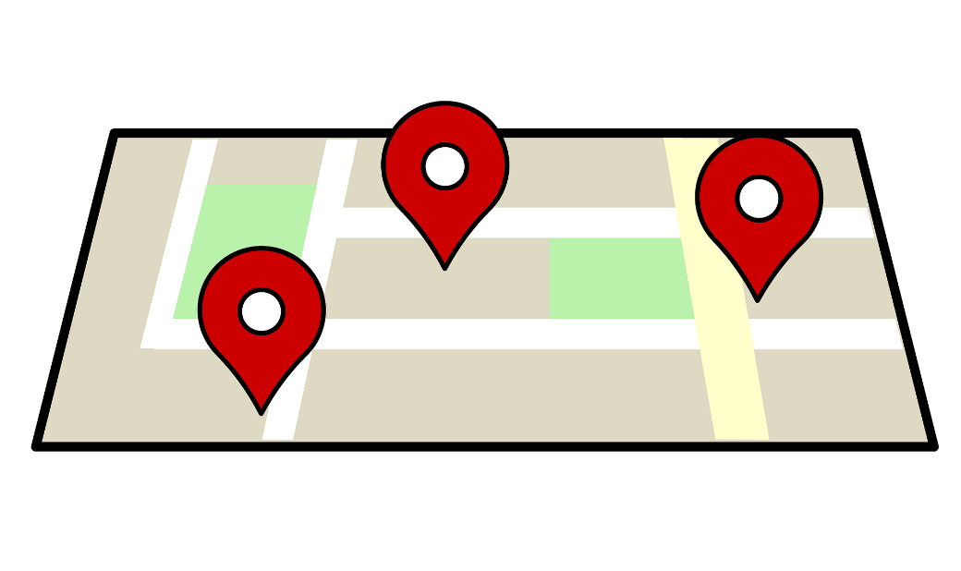

Error Resilient Applications
Image Processing & Compression
Biometric Security
Navigation
Web Browsing
No single accurate result!!!

Slide 14
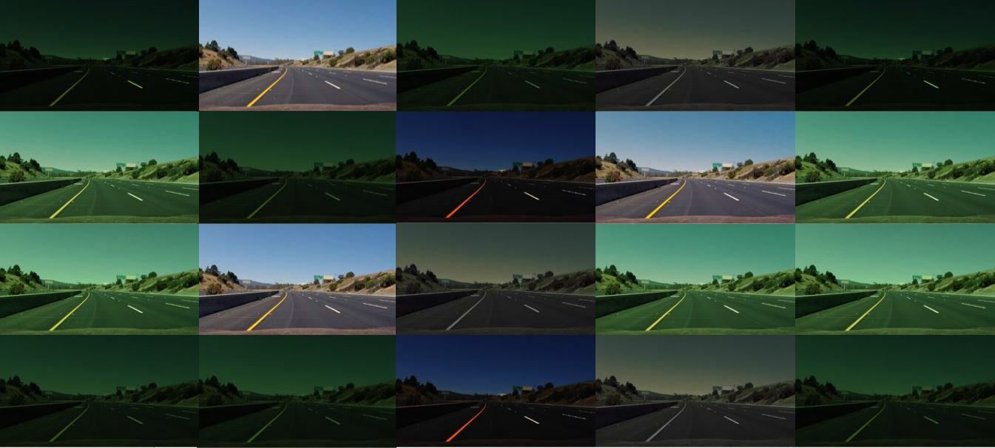
Approximate computing: Image approximation

Slide 15
Image Processing benefits from Approximate Computing!

Slide 16

But they are always part of bigger closed-loop systems.
Plant/ System
raw image
containing x[k]
u[k]
Camera Sensor
Image Processing
ISP
Controller

Slide 17
Image-approximation in-the-loop

Slide 18
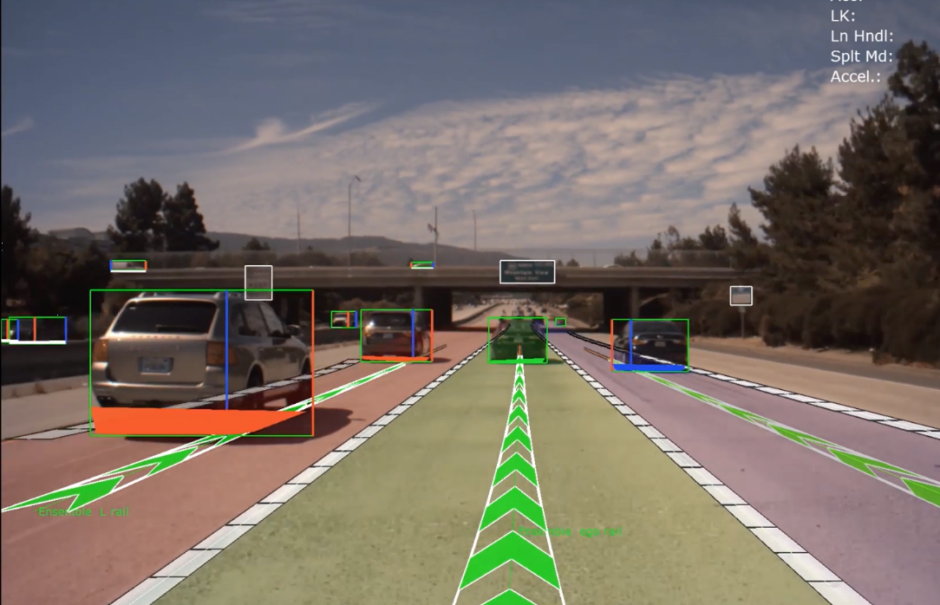
Lane keeping assist system (LKAS)
image
containing x[k]
u[k]
Camera Sensor
ISP
Image Processing
Controller
What is the impact of image approximation on the bigger closed-loop system?
How to analyse this impact?

Slide 19

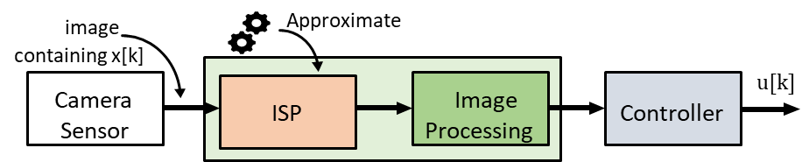

What should we approximate?
Raw Image Data
Raw Image Data
Raw Image Data
T_{S}
T_{C}
T_{A}
T_{S}
T_{C}
T_{A}
T_{S}
T_{C}
T_{A}
T_{S} | T_{C} | T_{A} | T_{S} | T_{C} | T_{A} | T_{S} | T_{C} | T_{A}
Compute Intensive
Approximate

Slide 20
Execution time analysis: profiling
What should we approximate?
Intel i7 processor @2.6GHz
ISP stage is the most compute-intensive → approximate
Raw Image Data
Raw Image Data
Raw Image Data
T_{S}
T_{C}
T_{A}
T_{S}
T_{C}
T_{A}
T_{S}
T_{C}
T_{A}
T_{S} | T_{C} | T_{A} | T_{S} | T_{C} | T_{A} | T_{S} | T_{C} | T_{A}
Time
Approximate the ISP!!

Slide 21
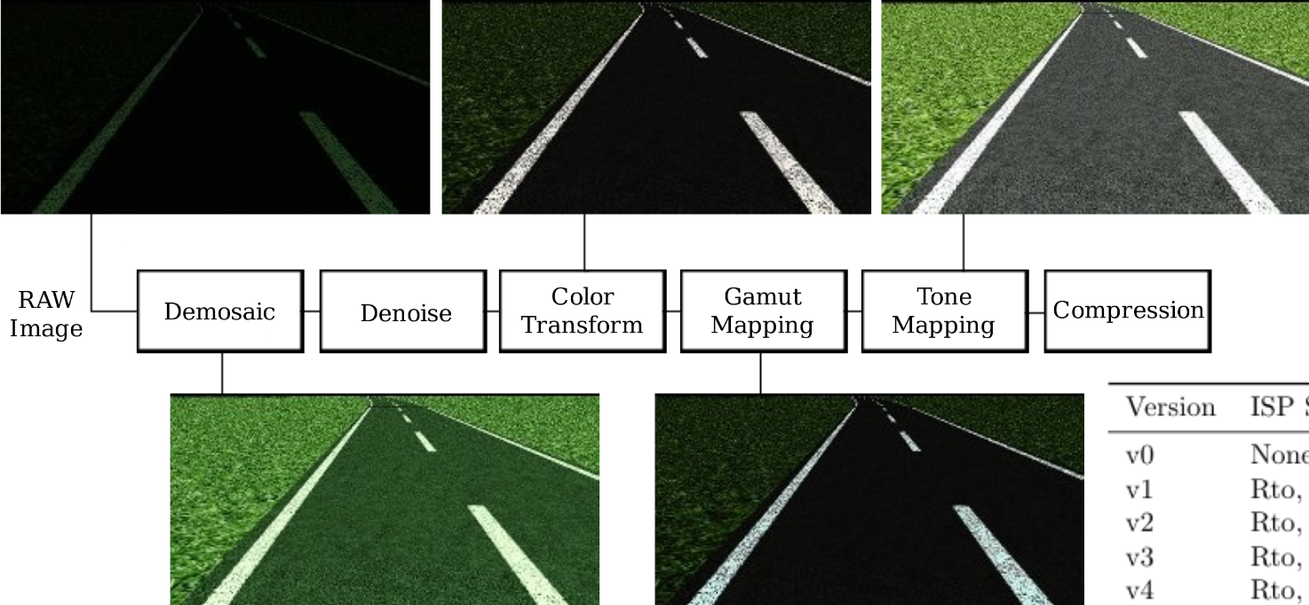
Image Signal Processor [ISP]
Traditional pipelines are optimized for vision.
Do we really need a vision optimized pipeline for control?

Slide 22
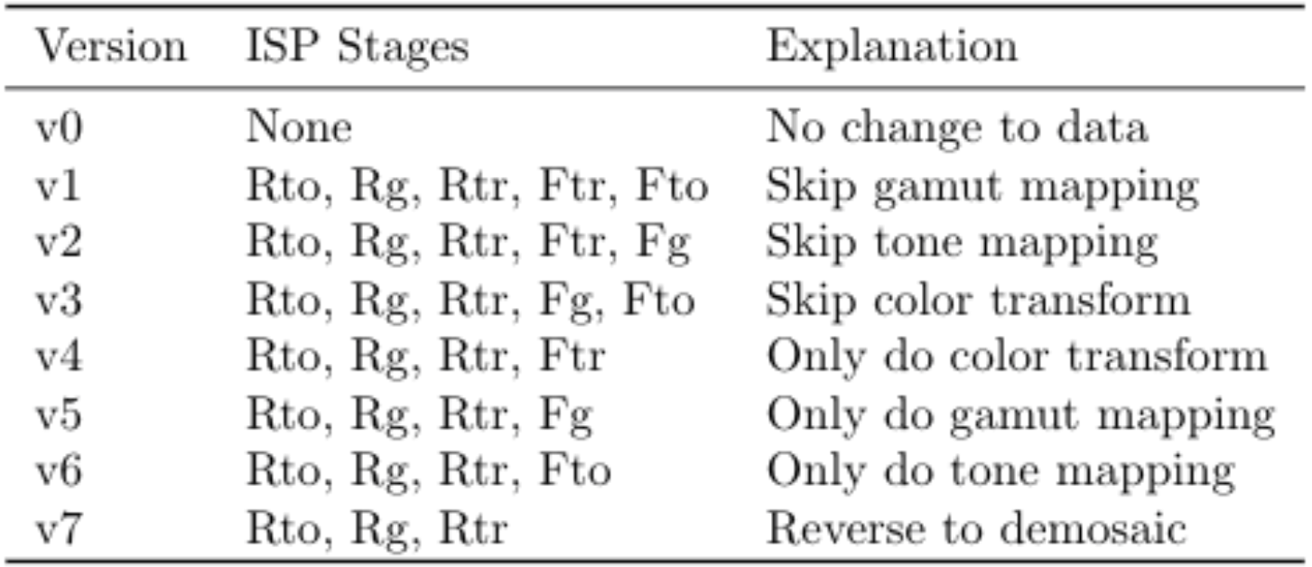
ISP Approximation: tuning knobs
Reconfiguring the Imaging Pipeline for Computer Vision, Buckler et al. [ICCV 2017]

Slide 23




What is the impact of approximation on IBC?
Reduced execution time
Loss of image quality
WCET
WCET
WCET
WCET

Slide 24

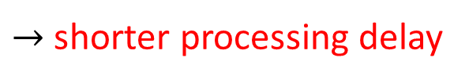


What is the impact of approximation on IBC?
Reduced execution times
Loss of image quality
$→$ shorter processing delay
$→$ better control performance
$→$ inaccurate computation of system states
$→$ errors might be significant

Slide 25
What is the impact of approximation on IBC?
due to
Reduced execution times
Loss of image quality
Degree of Approximation
Quality-of-Control (QoC)
Their interplay determines if we gain or lose
affects

Slide 26
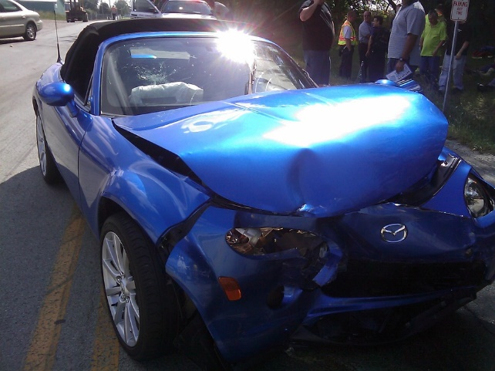
Impact on image quality
Features of image may not be detected
Algorithm should be resilient to approximation
Application-specific testing needed!

Slide 27
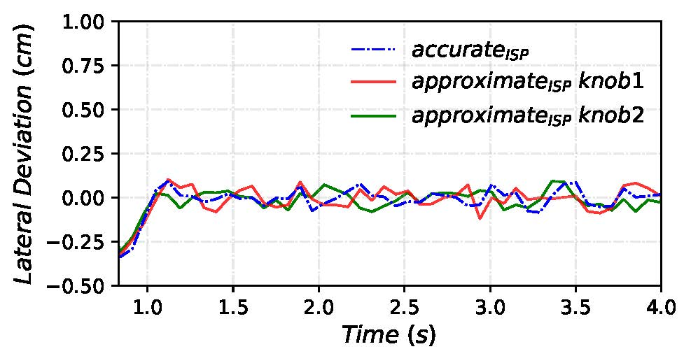
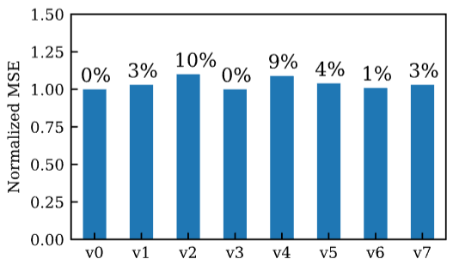
Impact of image quality on QoC
Without considering improved timing
Performance deteriorates for approximated images (v1 – v7)
Still acceptable for control

Slide 28
But timing is improved due to approximation!

Slide 29

How to check if it is safe to approximate images for safety-critical IBC systems?
Plant/ System
raw image
Approximate
containing x[k]
u[k]
Camera Sensor
ISP
Image Processing
Controller
An analysis framework is needed!!!

Slide 30
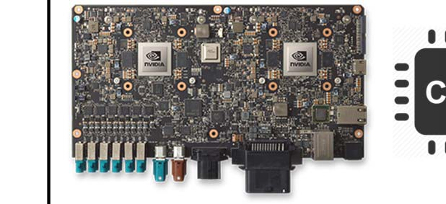

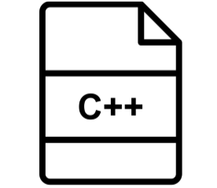

IMACS framework: software-in-the-loop & hardware-in-the-loop simulation
Plant/ System
Physics Simulation Engine + Actuation
raw image
Approximate
containing x[k]
u[k]
Camera Sensor
ISP
Image Processing
Controller
+
C++
Matlab
code
SiL
Nvidia Drive PX2
HiL

Slide 31
Plant/ System
Physics Simulation Engine + A: Actuation
raw image
IBC application
containing x[k]
S: Sensing
Camera Sensor
ISP
Image processing
C: Control computation
u[k]
+
Nvidia Drive PX2
HiL

Slide 32


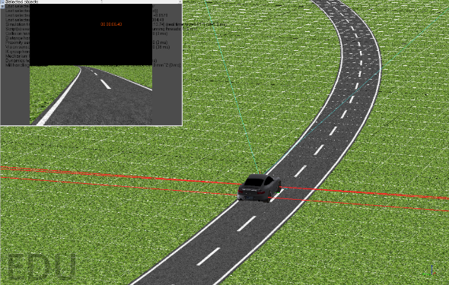
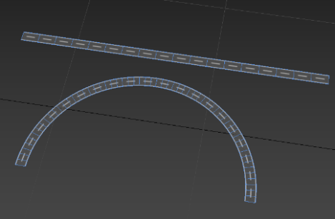

IMACS: SiL simulator
Simulation Environment
Import
Highway model
Server
Sensor Inputs
Control Inputs (Vehicle Actuation)
V-REP image
Control Performance
ISP
C++ /
Image Processing (IP)
code
Controller
Client
Output: update control inputs
http://www.es.ele.tue.nl/cps/automotive/#imacs

Slide 33
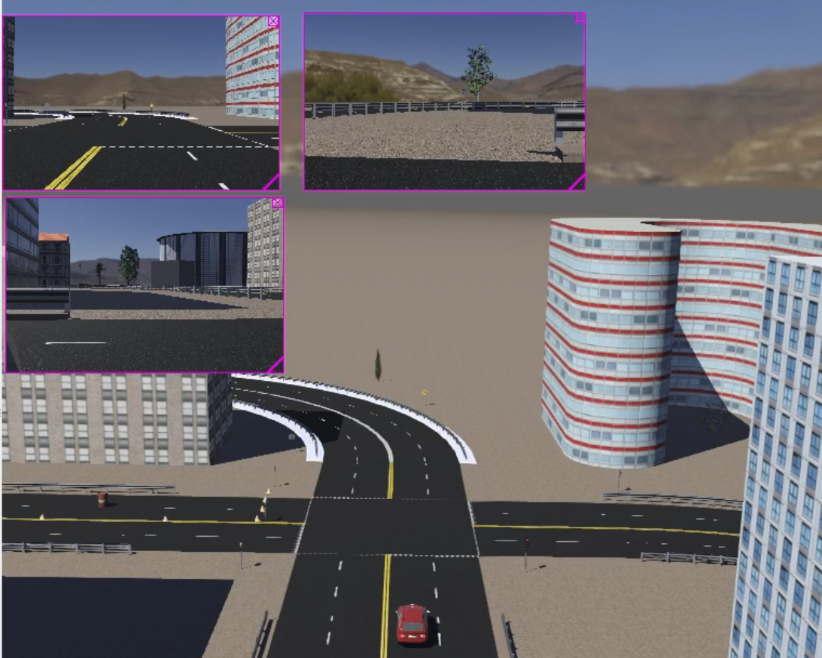
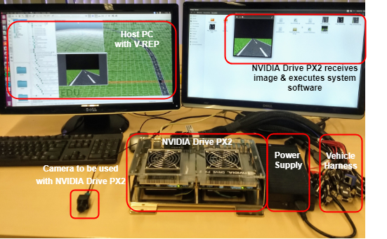
IMACS: HiL simulator
Simulation Environment
Import
Host PC
Sensor Inputs
Control Inputs (Vehicle Actuation)
image
TCP/IP
ISP
Image Processing (IP)
+
Controller
Nvidia Drive PX2
Output: update control inputs
http://www.es.ele.tue.nl/cps/automotive/#imacs

Slide 34
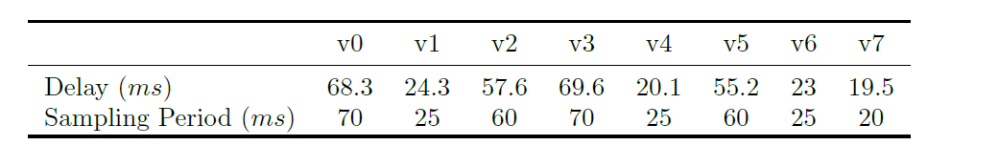
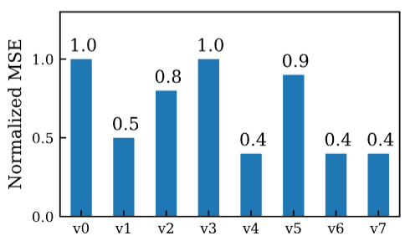
Results: Degree of approximation vs QoC
without considering improved timing
considering improved timing

Slide 35
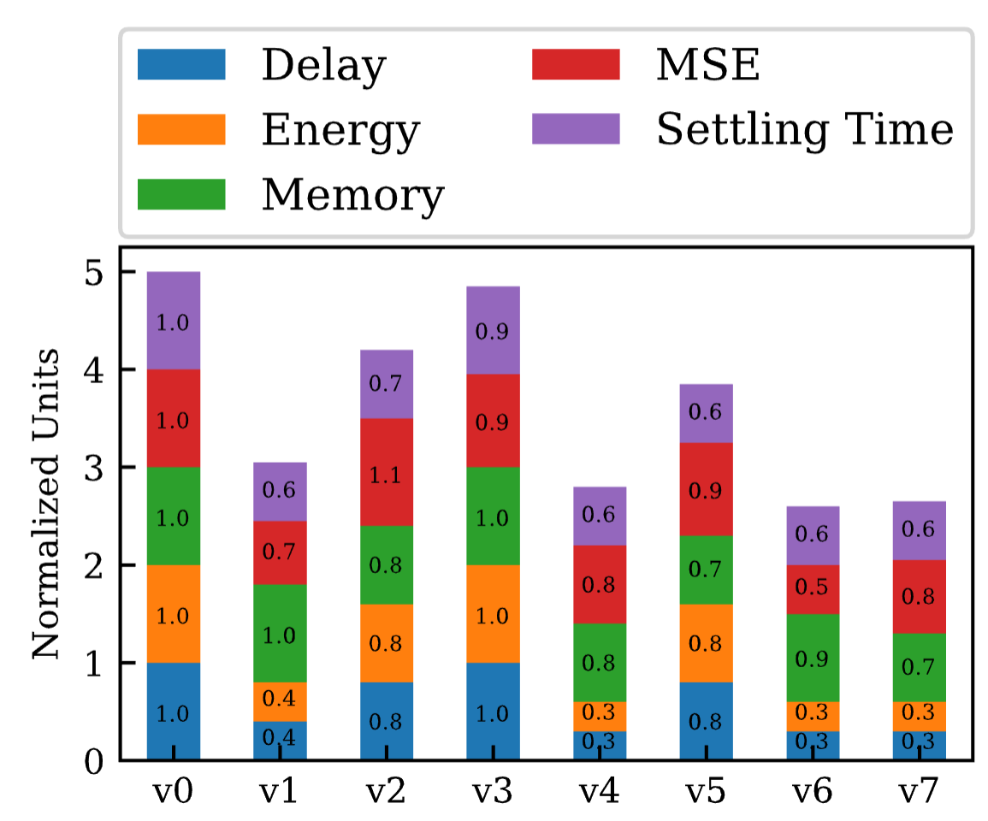
Results: Trade-offs wrt Degree of Approximation
QoC
Delay
Energy
Memory

Slide 36
Conclusions
Image-based control suffers from long processing delay;
Image-approximation is one promising approach to deal with long delay and save compute energy;
There are several knobs that decides the performance of the overall IBC system;
Extensive design space exploration is required to design sweet-spots;

Slide 37
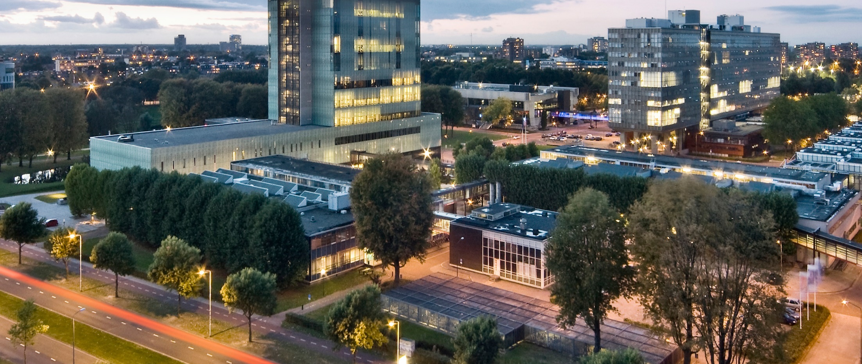

http://www.es.ele.tue.nl/cps/automotive/#imacs
S.Mohamed@tue.nl

